Slide 1
Design and Implement Loadable Kernel Module and User Space Module
Prachi Shirode
Raksha Gopal Kulkarni

Slide 2
Index
Introduction
Plan of Project
Hardware and Software used
Hardware Connection
Project Progress
Milestones covered & Next Steps

Slide 3
Introduction
Automation demands that Embedded Systems make real time computation.
There are two levels in OS: User Space & Kernel Space. Program for sensor reading can be developed in either one. User space does not have direct access to hardware and has limited memory, while kernel has the direct hardware access and no restriction on memory.
In this project we plan to show this difference in the response time of a user space program with the kernel space program for the real time scenario on the Raspberry Pi 3 Platform.

Slide 4
Plan of Project
To implement a loadable kernel module and a user space module for a task and compare their performance based upon the execution time.
We have implemented a module for incubator in user space which includes reading the data from sensor , averaging the read values and the state of incubator is displayed through LEDs.
Since, reading sensor values is critical we will be implementing it in kernel space module.

Slide 5
Hardware and Software used
Hardware Components
Raspberry Pi 3, temperature and humidity sensor (DHT22) (3 in number), breadboard, 3 LEDs, 5.1kΩ resistor, 220Ω resistor and jumper wires.
Software Components
Operating system used on Pi: Raspbian Jessi
Tools used: VNCViewer, Git, WinSCP, GCC compiler
Programming language used: Python, C

Slide 6
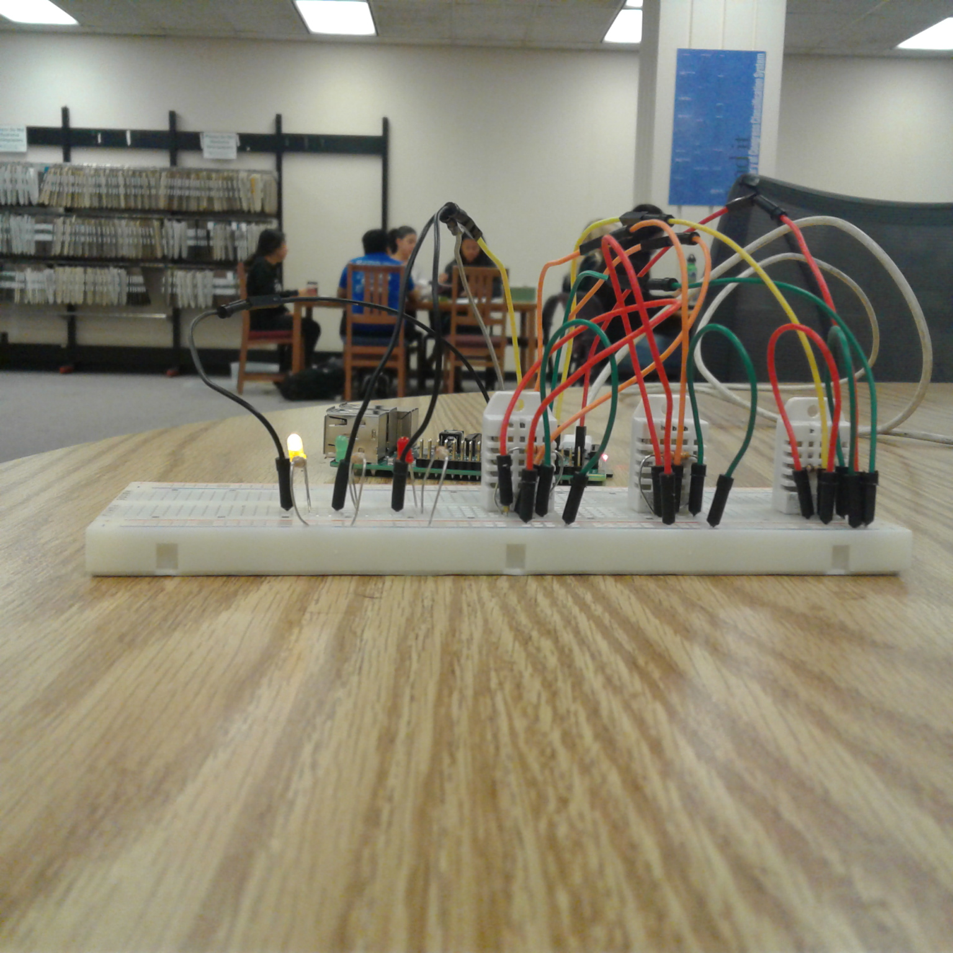
Hardware Connection

Slide 7
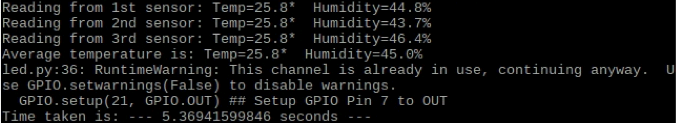
Project Progress
User space: Read the temperature and humidity values from the sensor, did the averaging of values using python and LED was used for displaying the incubator state.

Slide 8
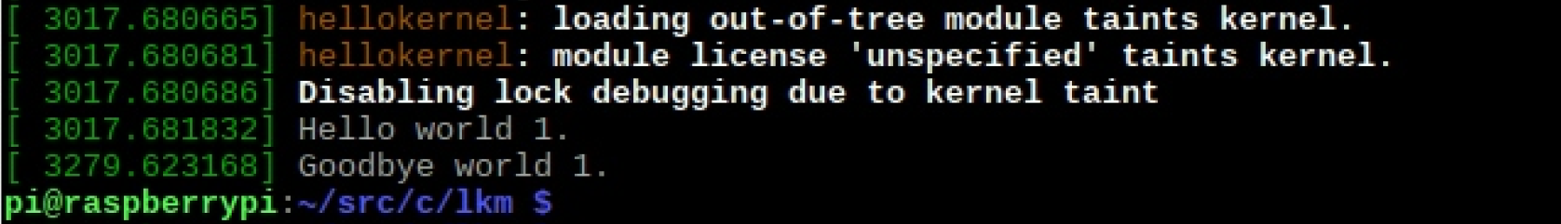
Project Progress
Kernel space: Implemented “hello world” and “goodbye world” in the kernel space using C.

Slide 9
Milestones Covered & Next Steps
Setting up the Raspberry pi , studying datasheet of sensor, developing user space module.
We have covered all the milestones till date as proposed in the project proposal. Also, we implemented Hello world module in kernel space.
To implement the temperature-humidity program in kernel space and compare it with the user space in terms of execution time.

Slide 10
Questions ?

